Slide 1
Project 1 Status Report
Charlotte Teague
CS 418
February 4, 2015

Slide 2
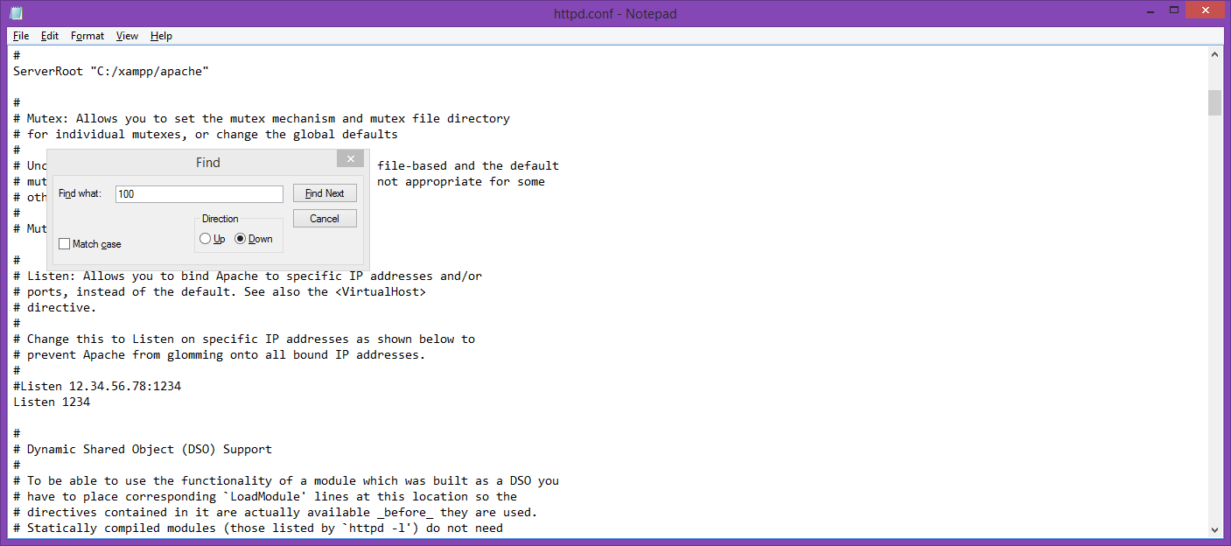
I had to change the port number from 80 to anything. I chose 1234.

Slide 3
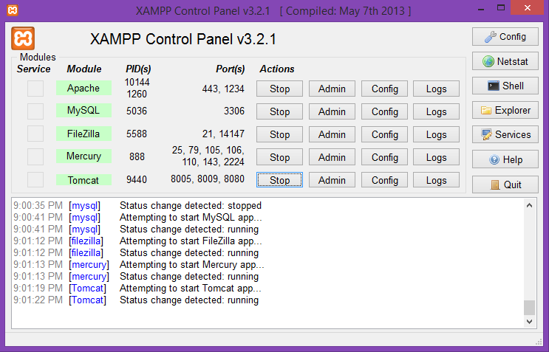
I started the XAMPP processes

Slide 4
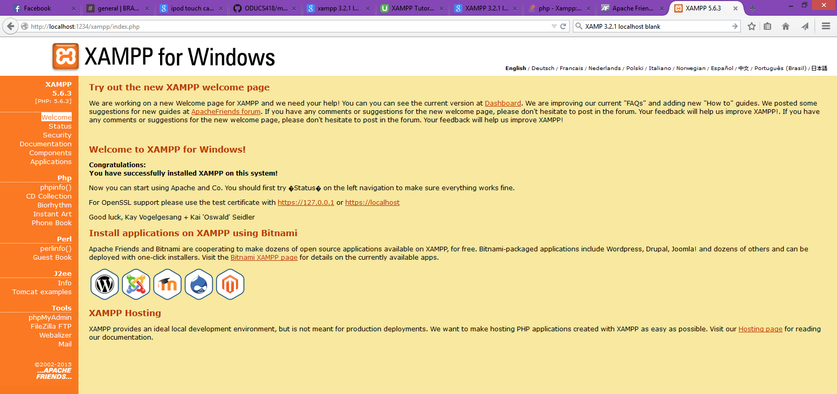
I then proceeded to test the installation.

Slide 5
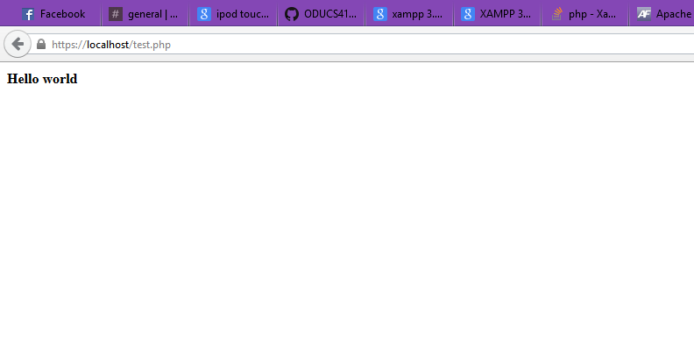
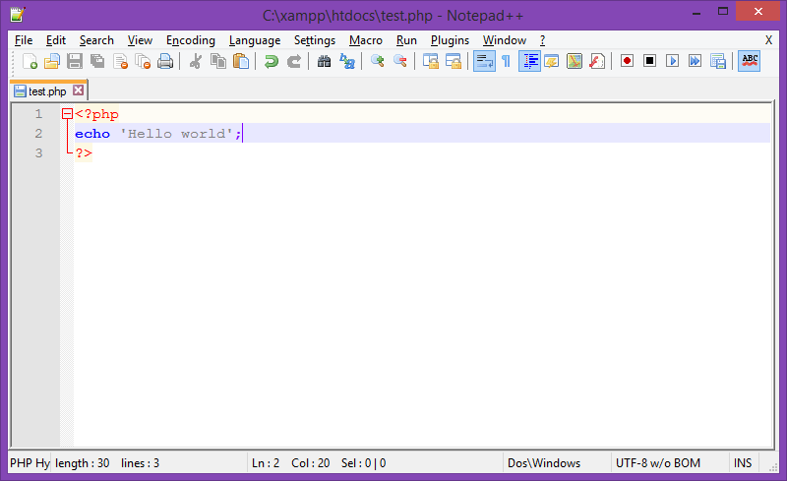
I created a php ‘Hello world’ file and tested the file.

Slide 6
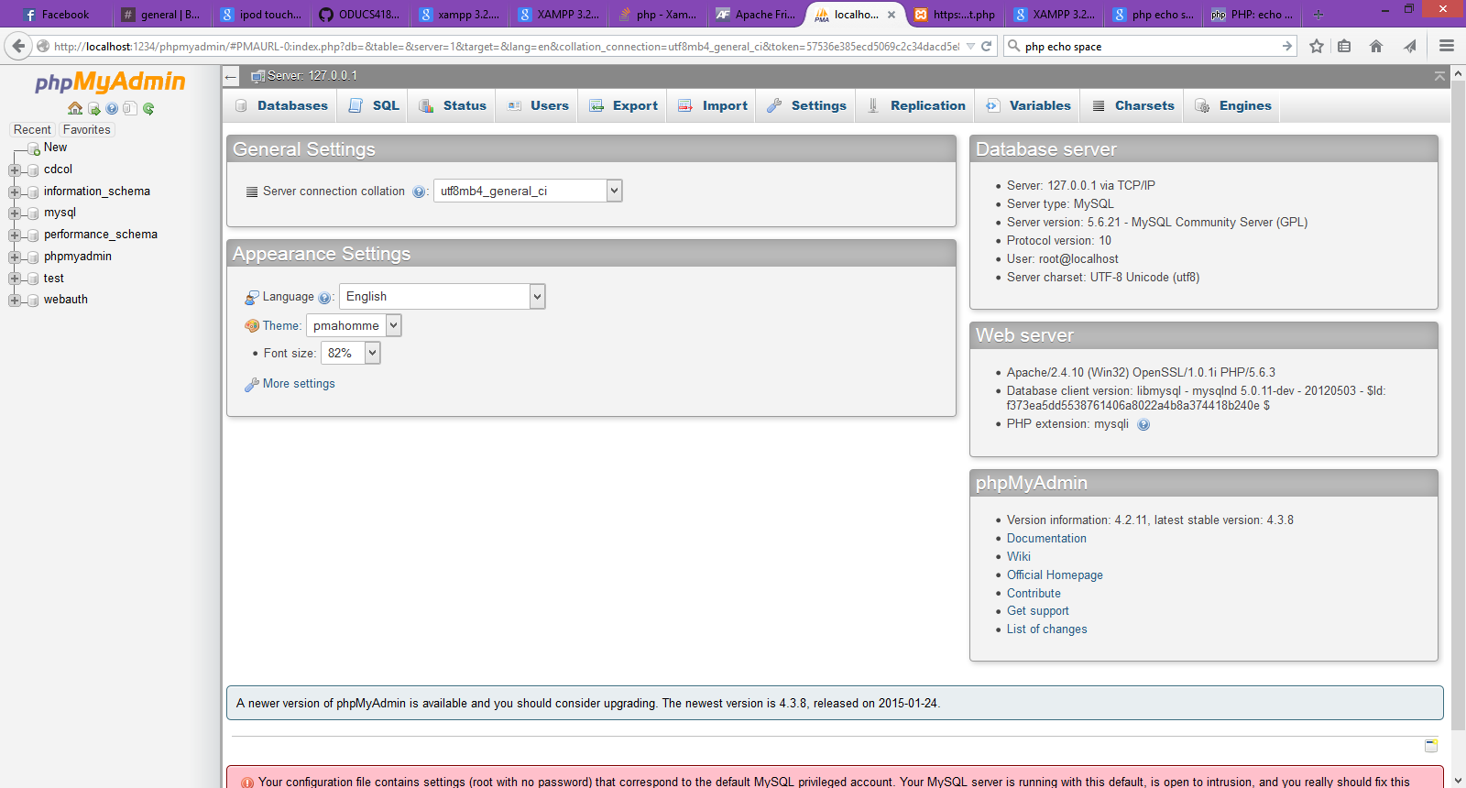
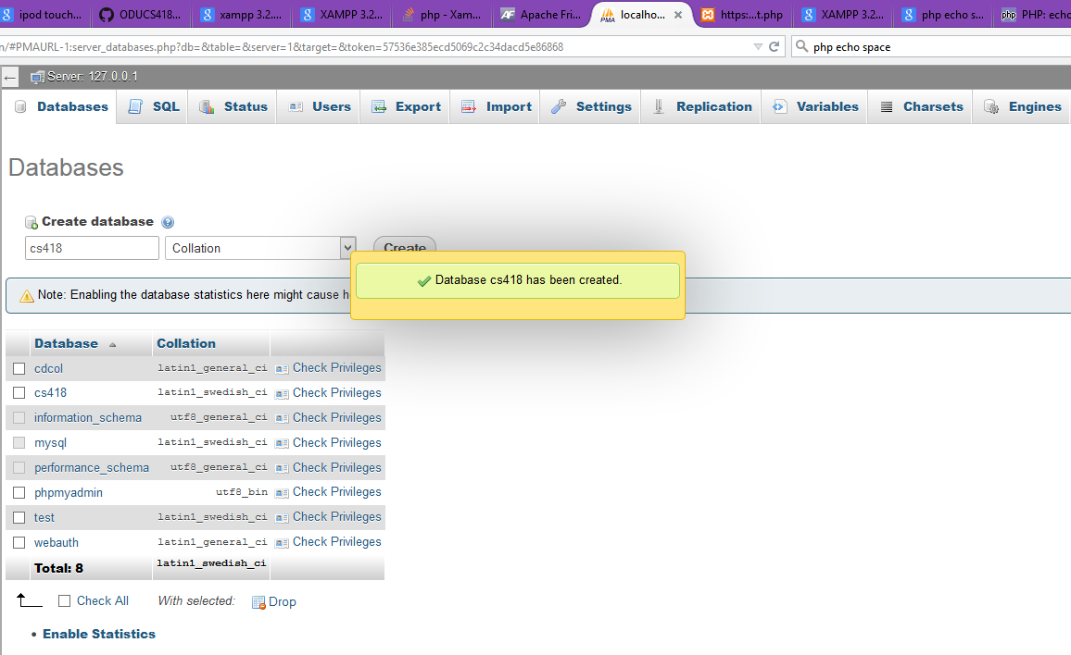
I opened myPHPAdmin and created a database titled ‘cs418’

Slide 7
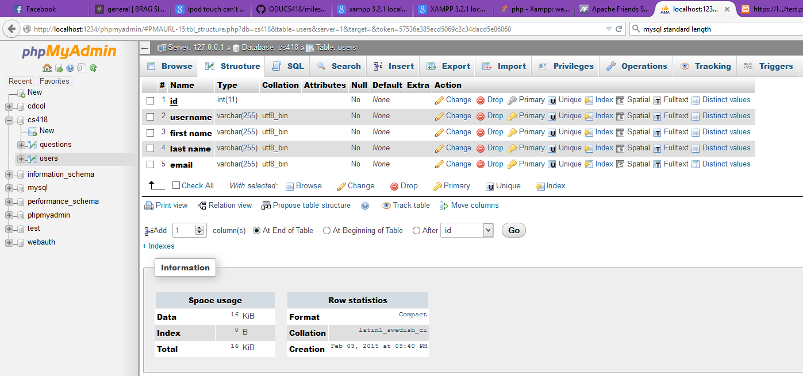
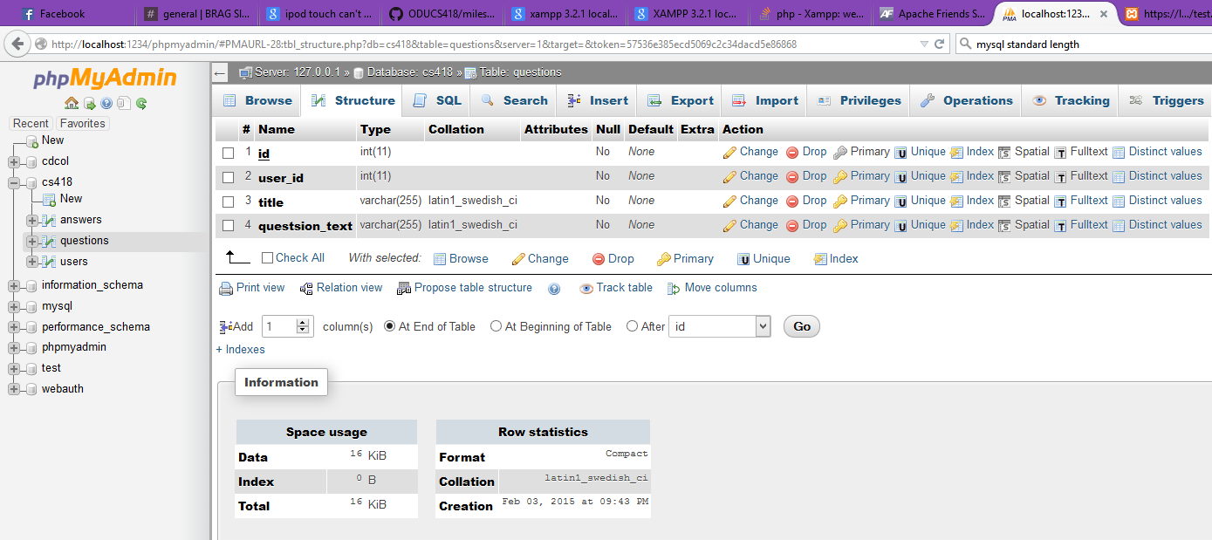
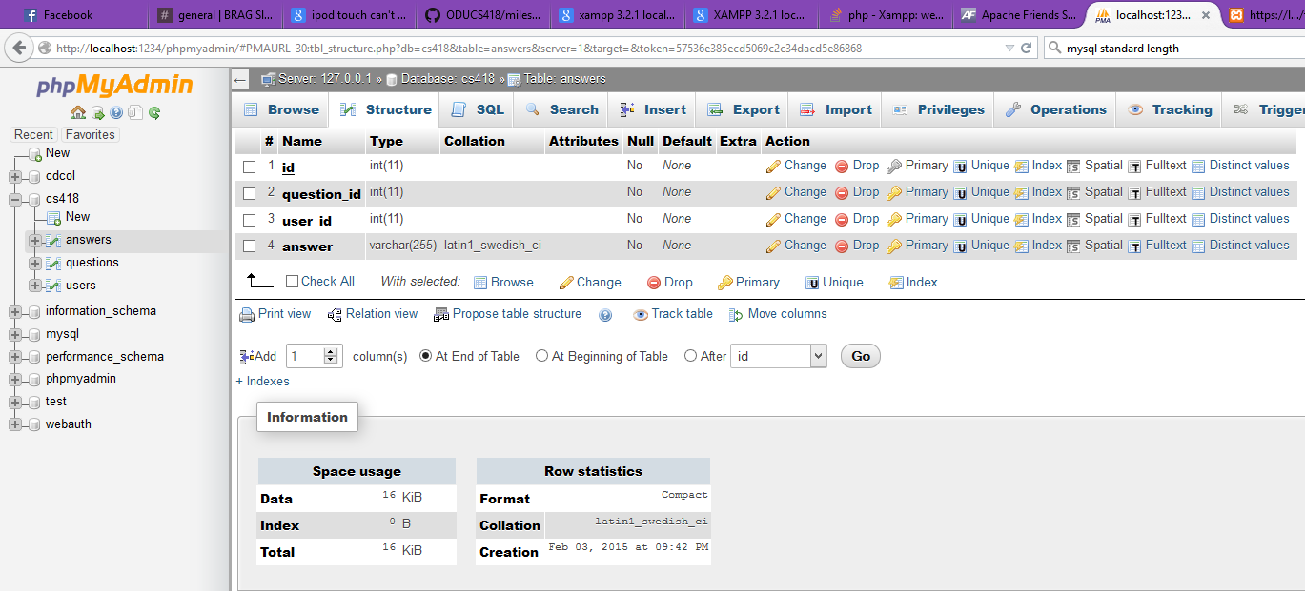
I then created tables titled ‘users’, ‘questions’, and ‘answers’

Slide 8
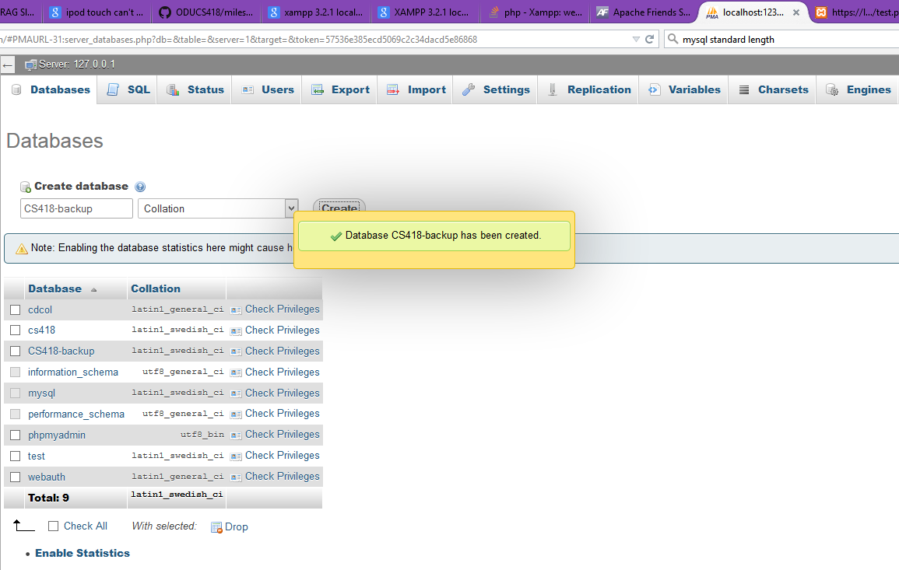
Finally, I created a back-up database

